Slide 1
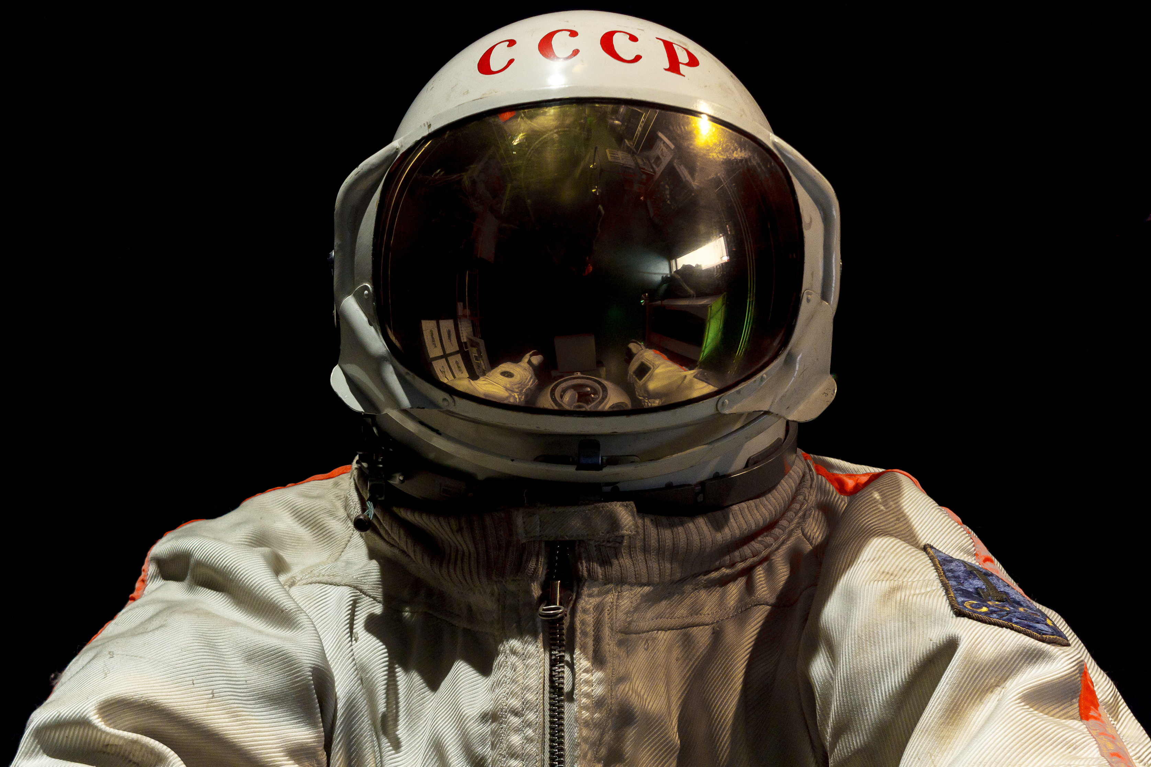

TECH TITANS
CORE
COMPONENTS

Slide 2
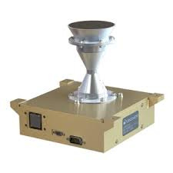

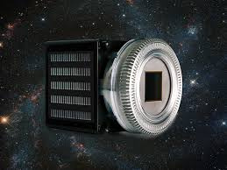
CAMERAS
SPACECAM 4K from Voyager Technologies
Teledyne Space Imaging Cameras
SAAZ Micro Space-Qualified Camera Systems

Slide 3
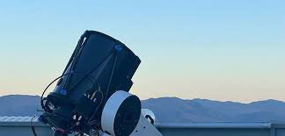
SENSORS
iSEE Radar Fence (from StartUs Insights companies)
NASA's SQRLi LIDAR
Copernilabs Multi-Sensor Platform
Spaceflux Optical Sensors

Slide 4
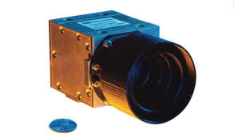
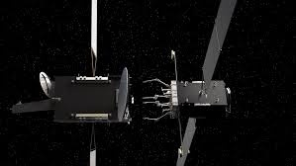
Redwire Star Trackers and Camera Systems
Kurs Orbital Machine Vision and Laser Rangefinders
Lulav Space Lunar Landing Sensor
NAVIGATOR

Slide 5
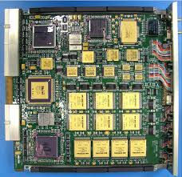
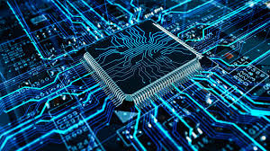
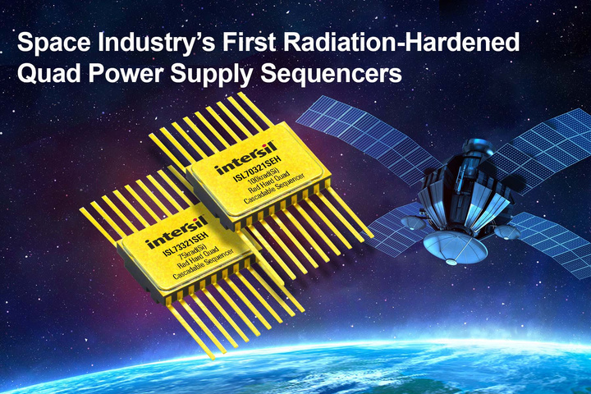
COMPUTER
VORAGO VA41630 Microcontrolle
Moog Bandera 3U/6U SpaceVPX SBC
BAE Systems RAD750 SBC

Slide 6
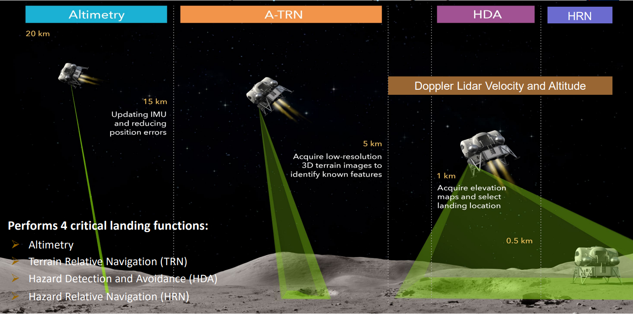
LASER
Orbital Lasers Satellite-
Based System
ESA's Laser Ranging Stations
WVU Ground-Based Laser
Ablation

Slide 7
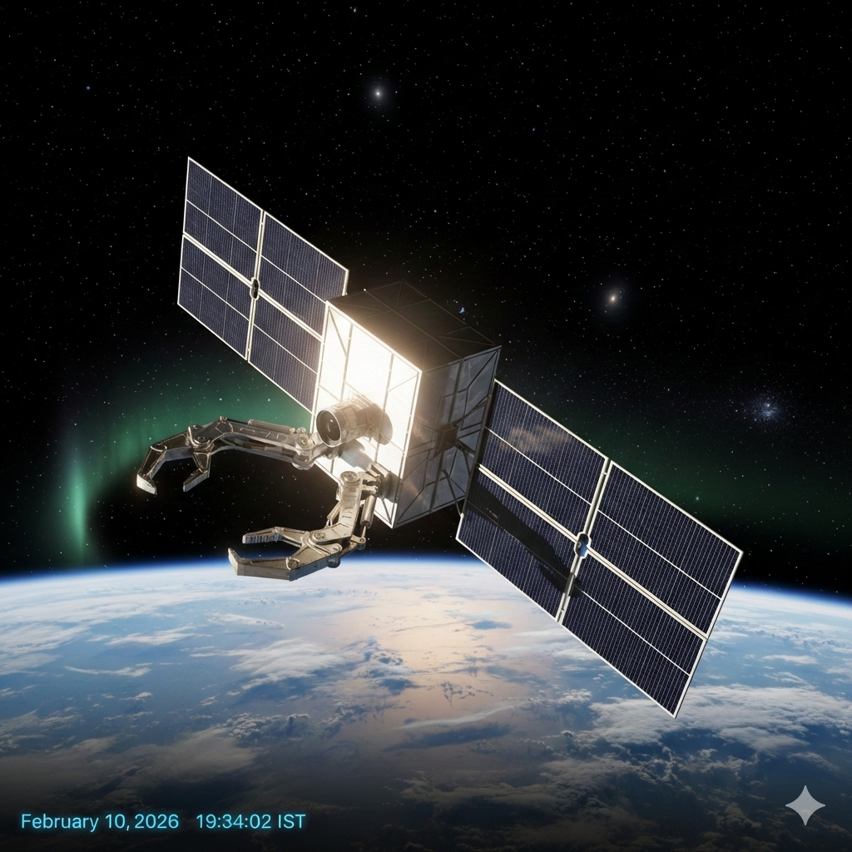
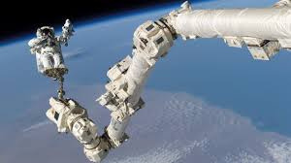
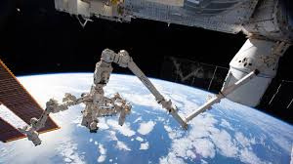
ROBOTIC ARM
Astroscale/MDA Robotic Arm
Delta Infinite Precision Robotics
Kurs Orbital Multi-Axis Arm

Slide 8
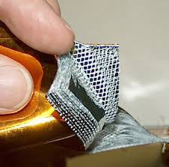
Overall: Radiation-Hardened Plastics from Renesas
Thermal Protection: Multi-Layer Insulation (MLI) Blankets
Structural: Lightweight Aluminum/
Composites
Radiation Shielding: Tungsten/Tantalum or Boron/Beryllium Composites
SATELLITE MATERIALS FOR LONGEVITY

Slide 9

THANK YOU

